Slide 1
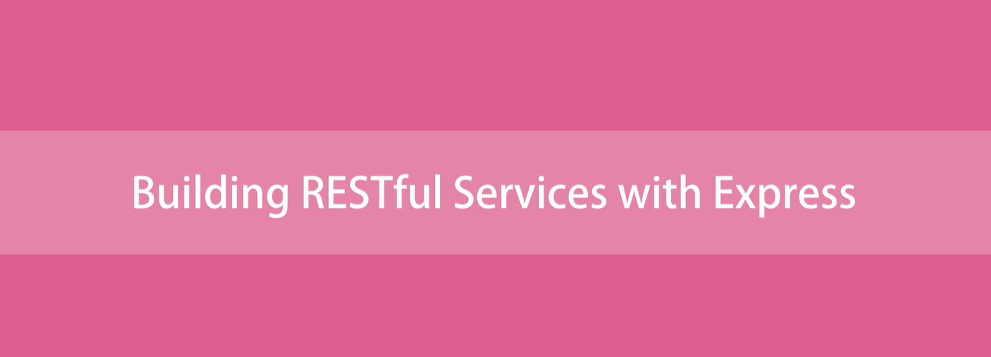

Slide 2
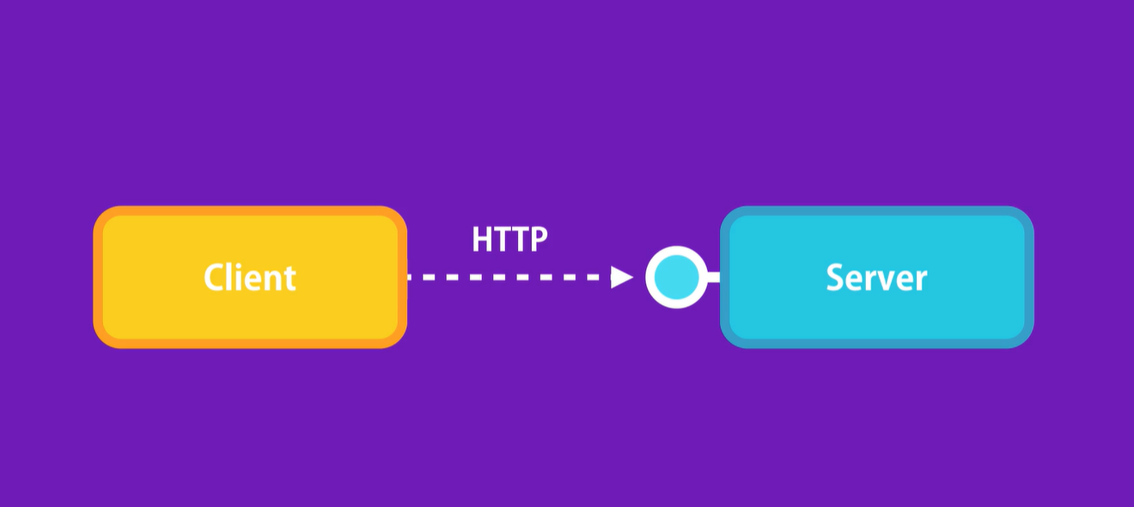

Slide 3
Fast and lightweight framework for building web application
Express

Slide 4
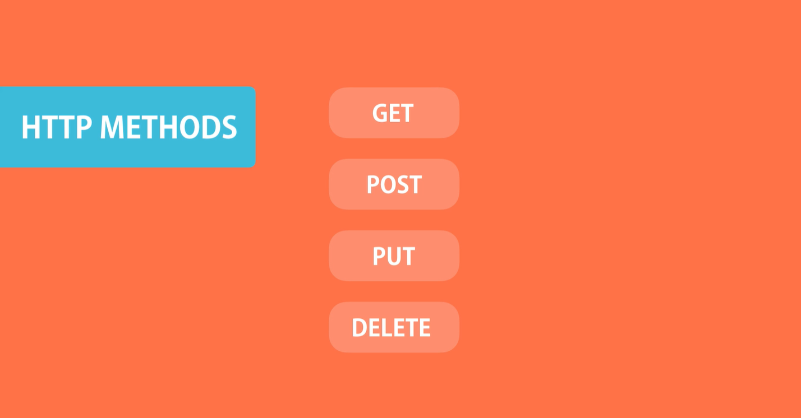

Slide 5
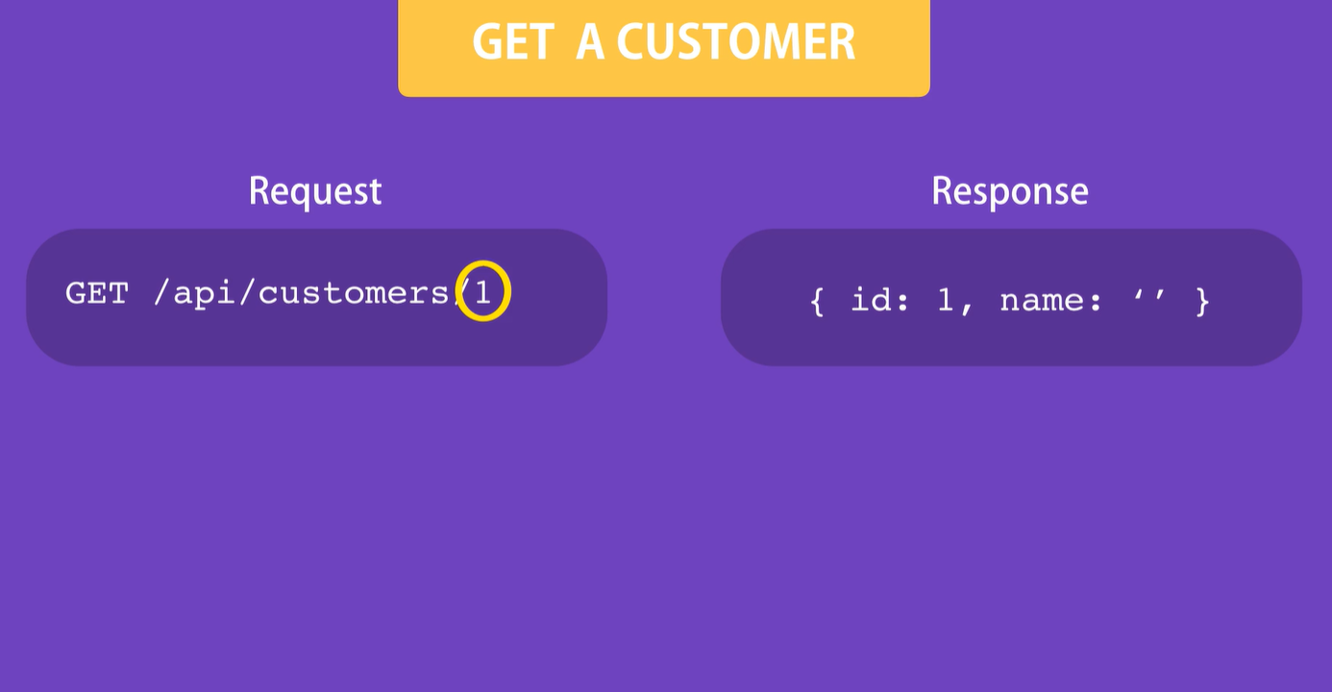

Slide 6
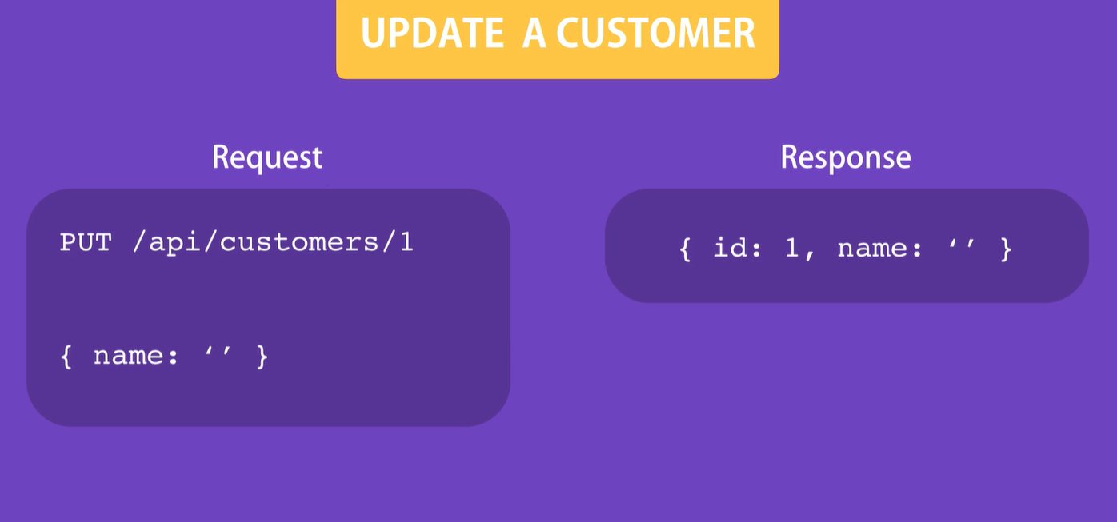

Slide 7
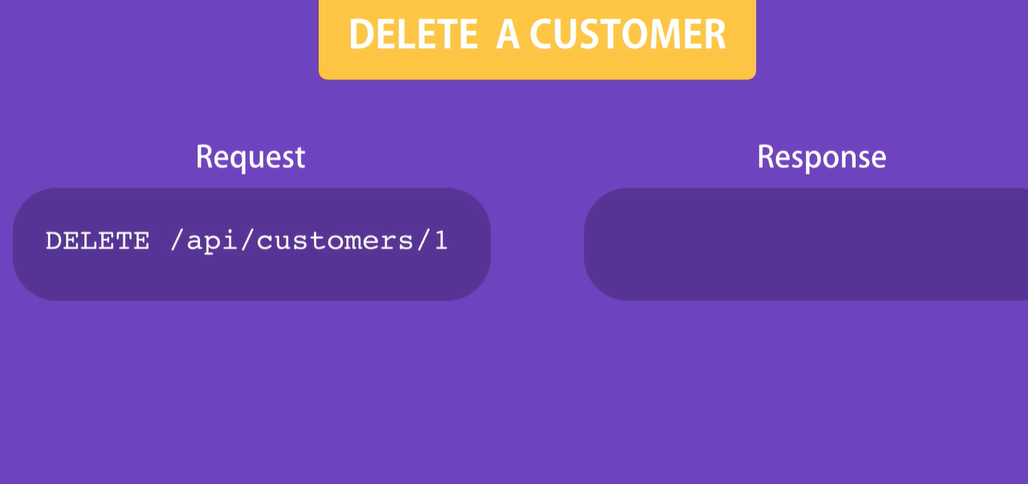

Slide 8
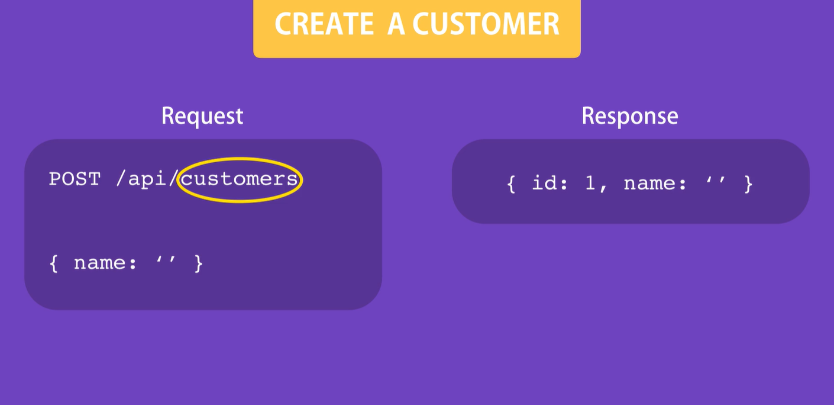

Slide 9
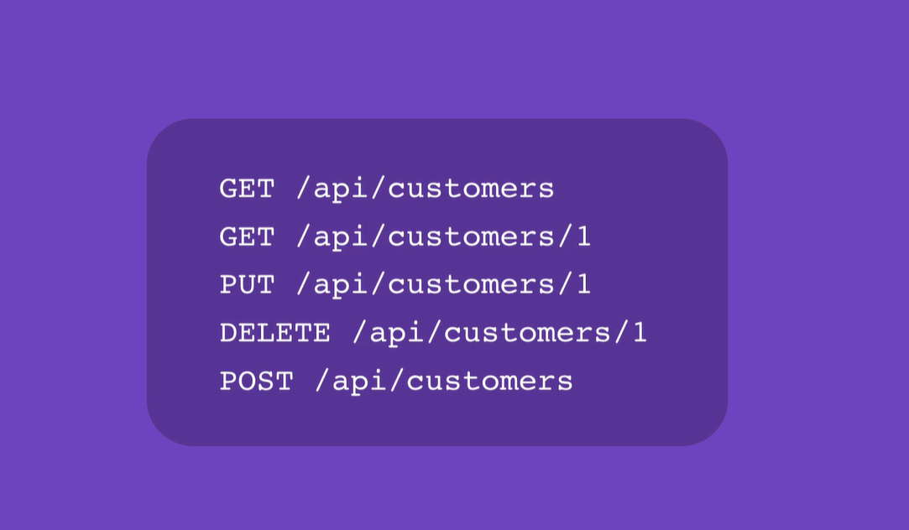
Restful Conventions

Slide 10
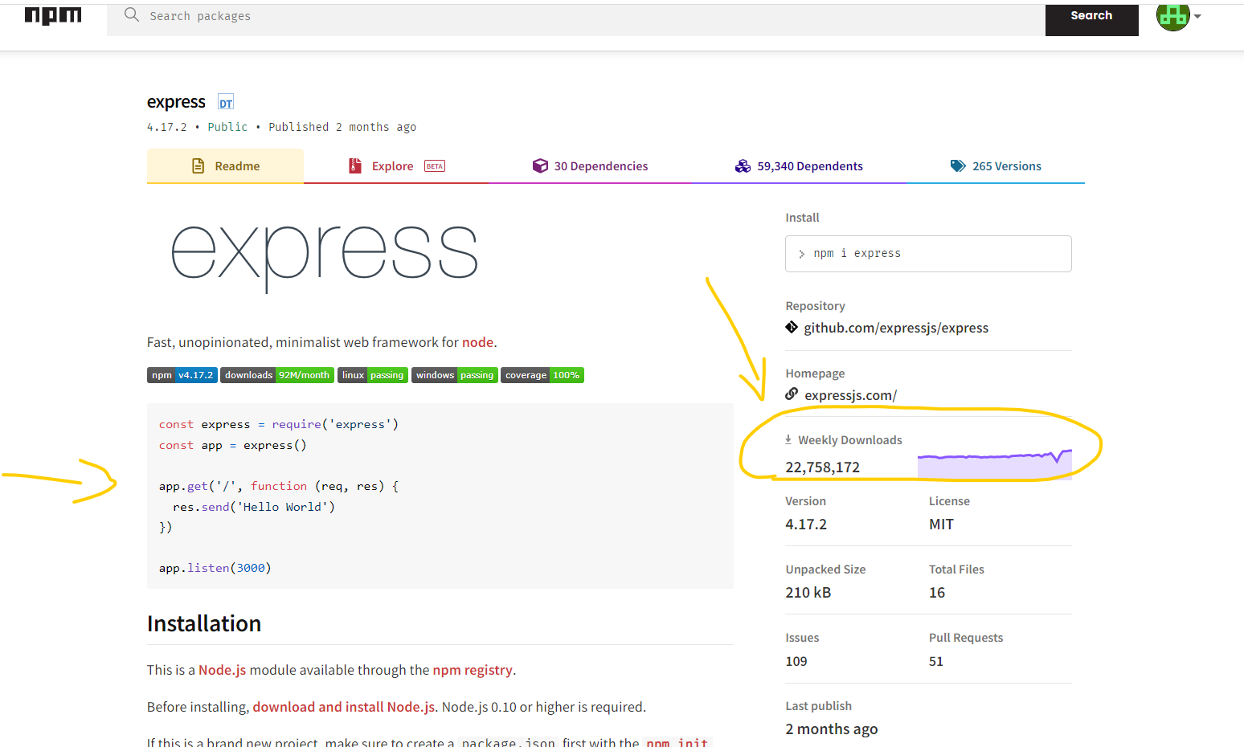

Slide 11


Create New Project

Slide 12
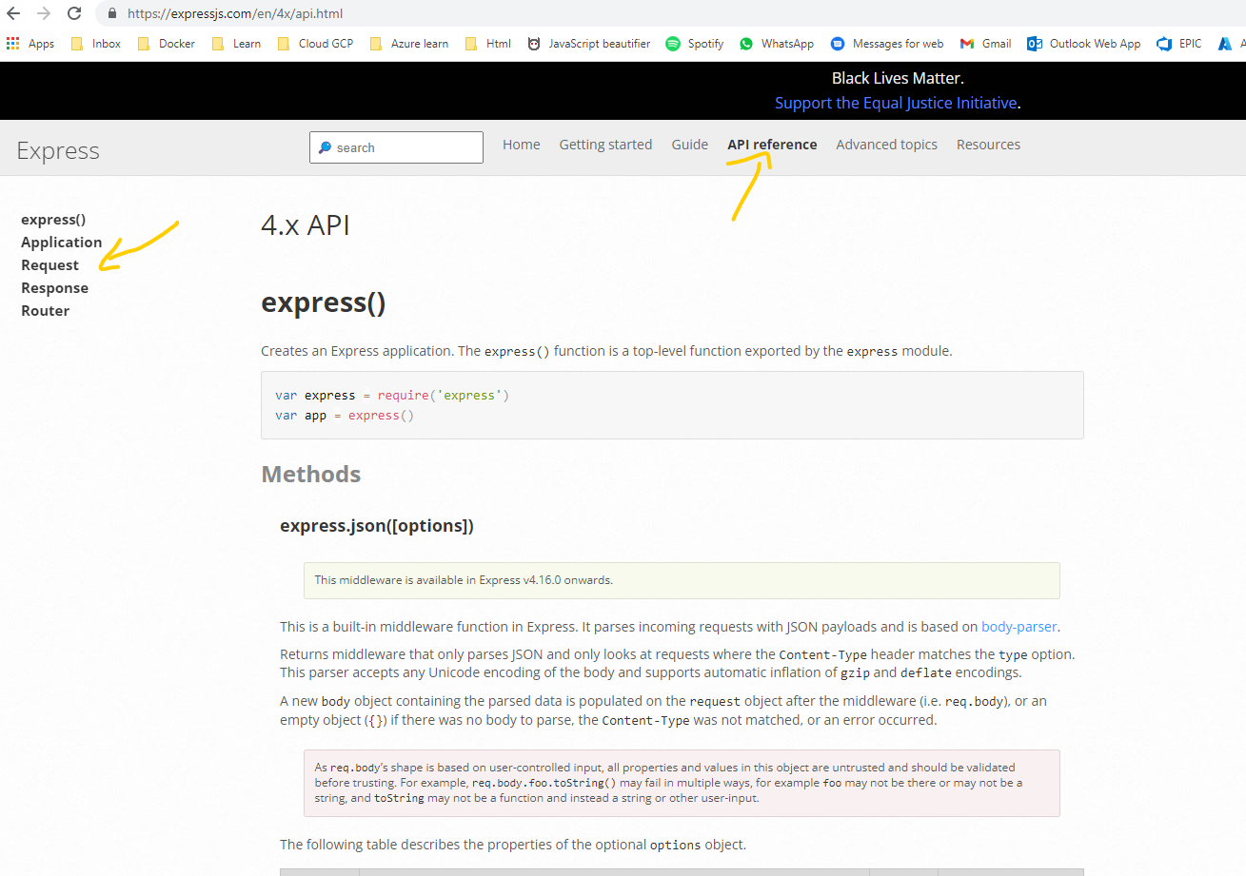
Read more about express documentation
Link

Slide 13
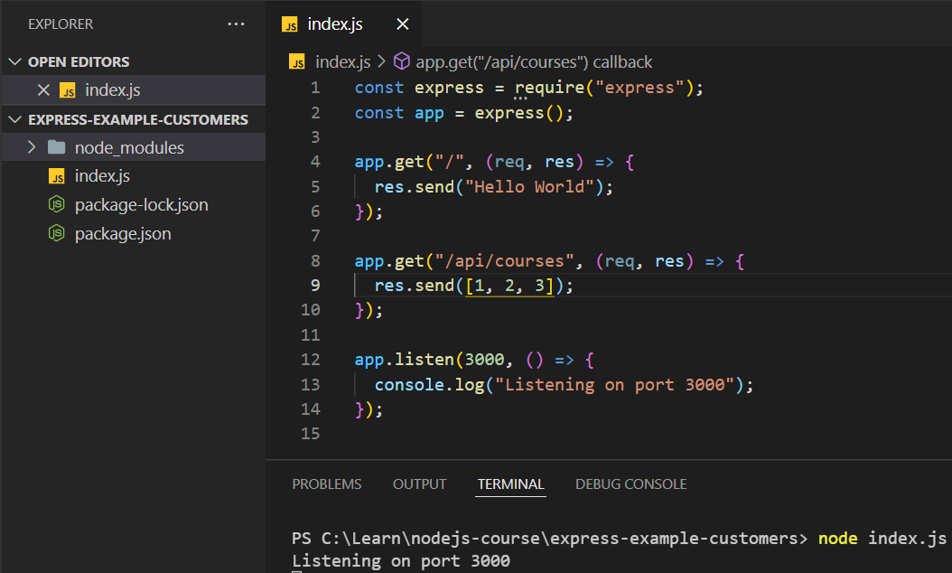
Building Your First Web Server

Slide 14



Nodemon

Slide 15
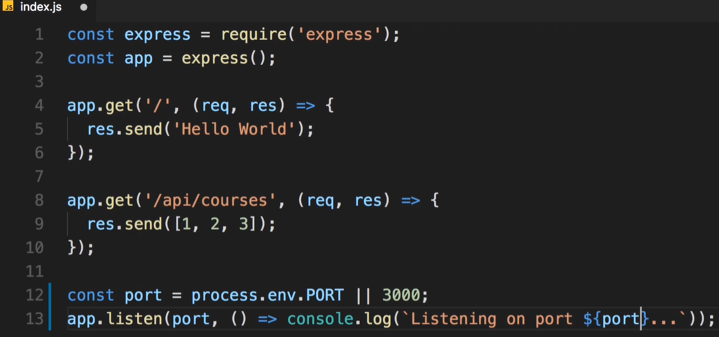
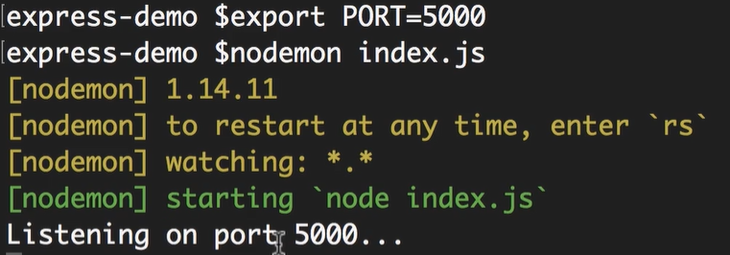
Environment Variables

Slide 16
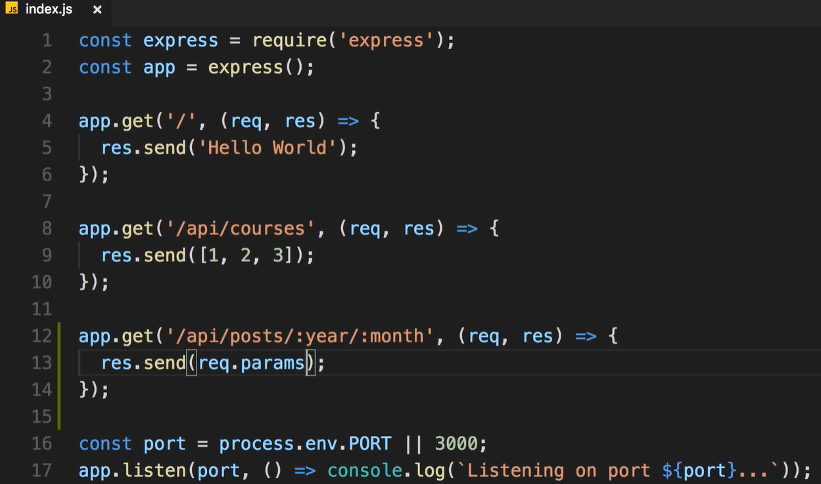
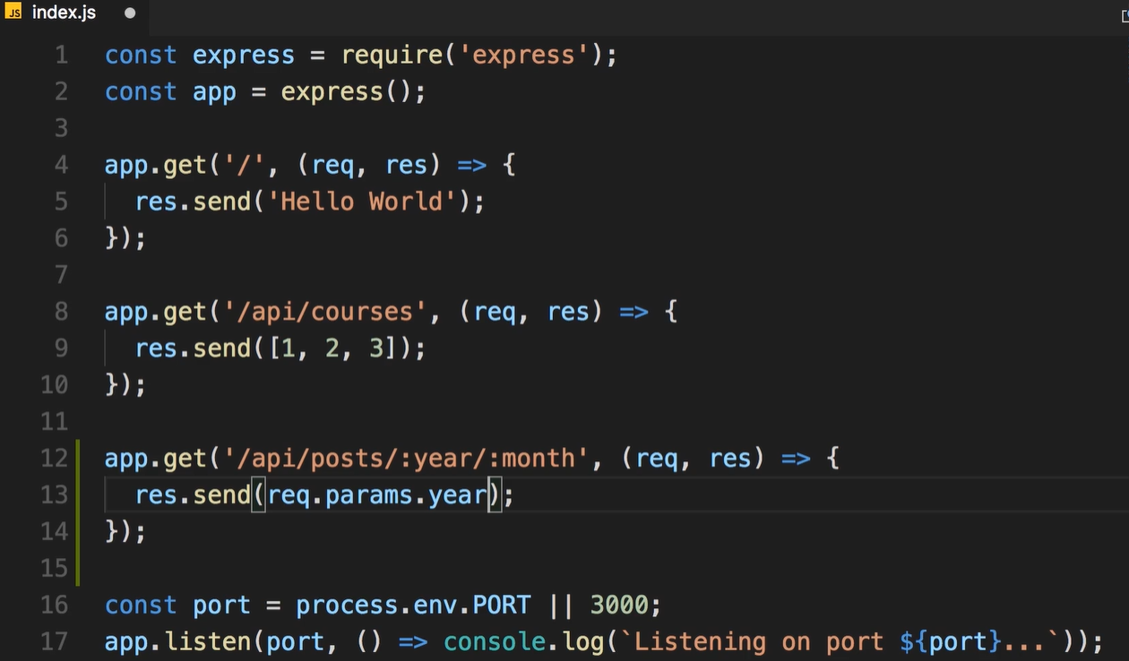
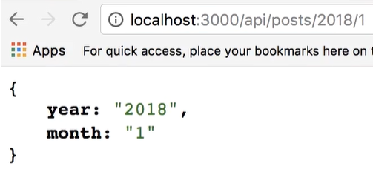
Route Parameters

Slide 17
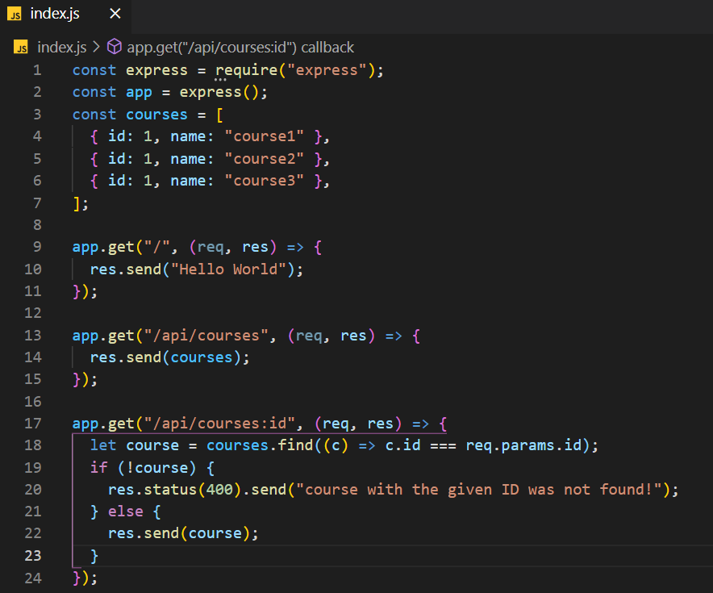
Handling HTTP GET Requests

Slide 18
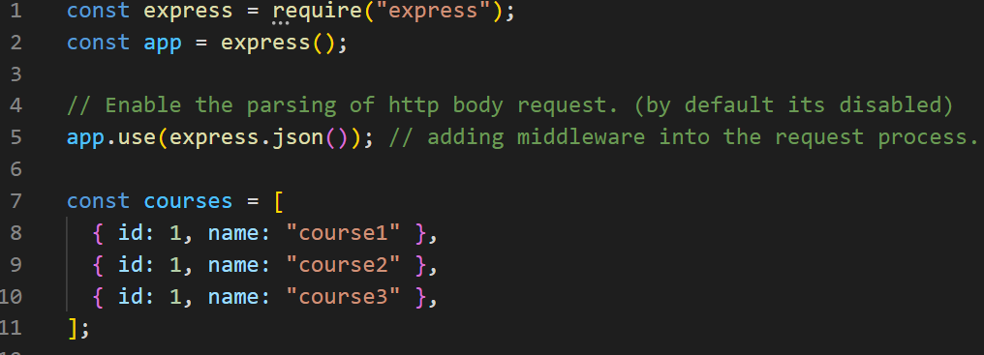
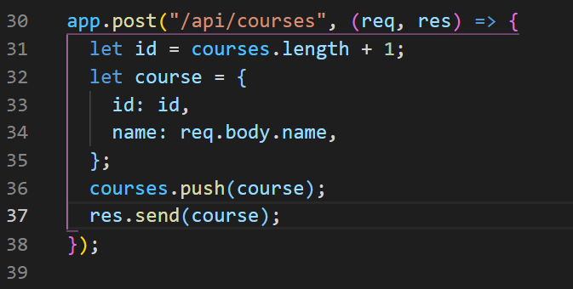
Handling HTTP POST Requests

Slide 19
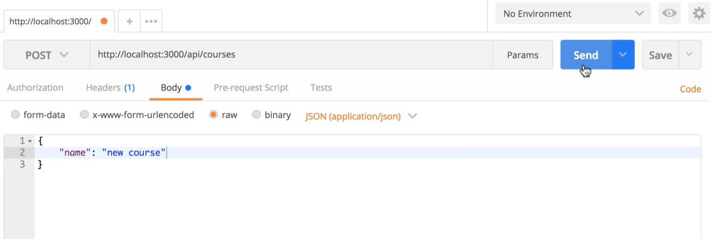
Calling Endpoints Using Postman

Slide 20
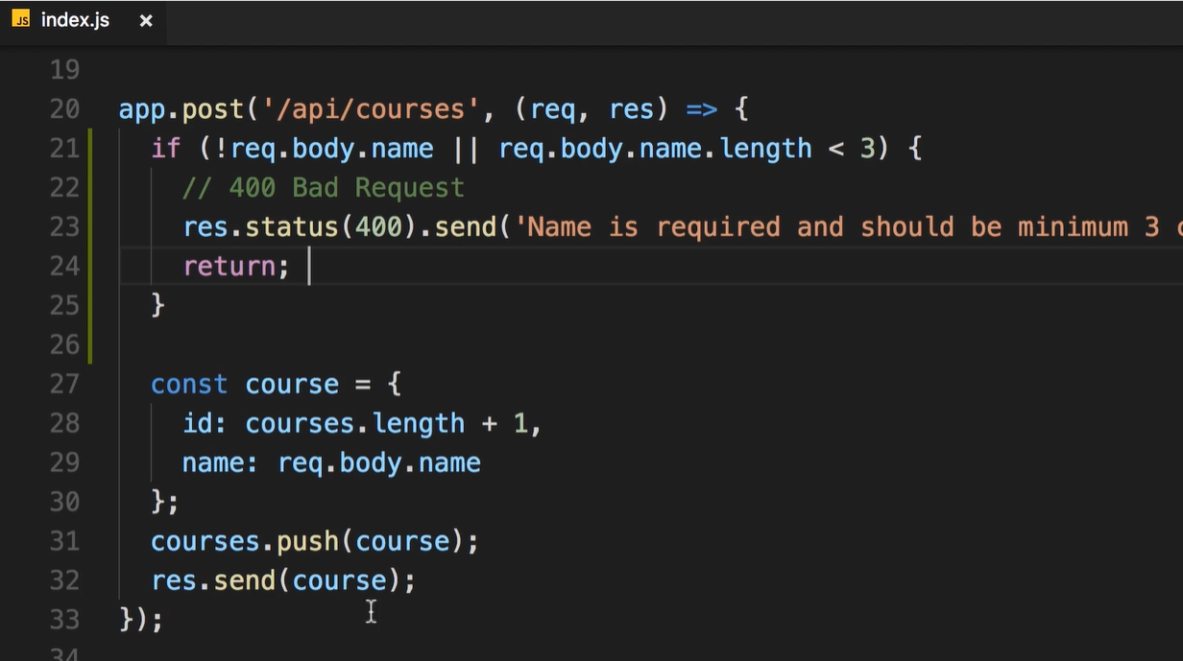
Input validation

Slide 21
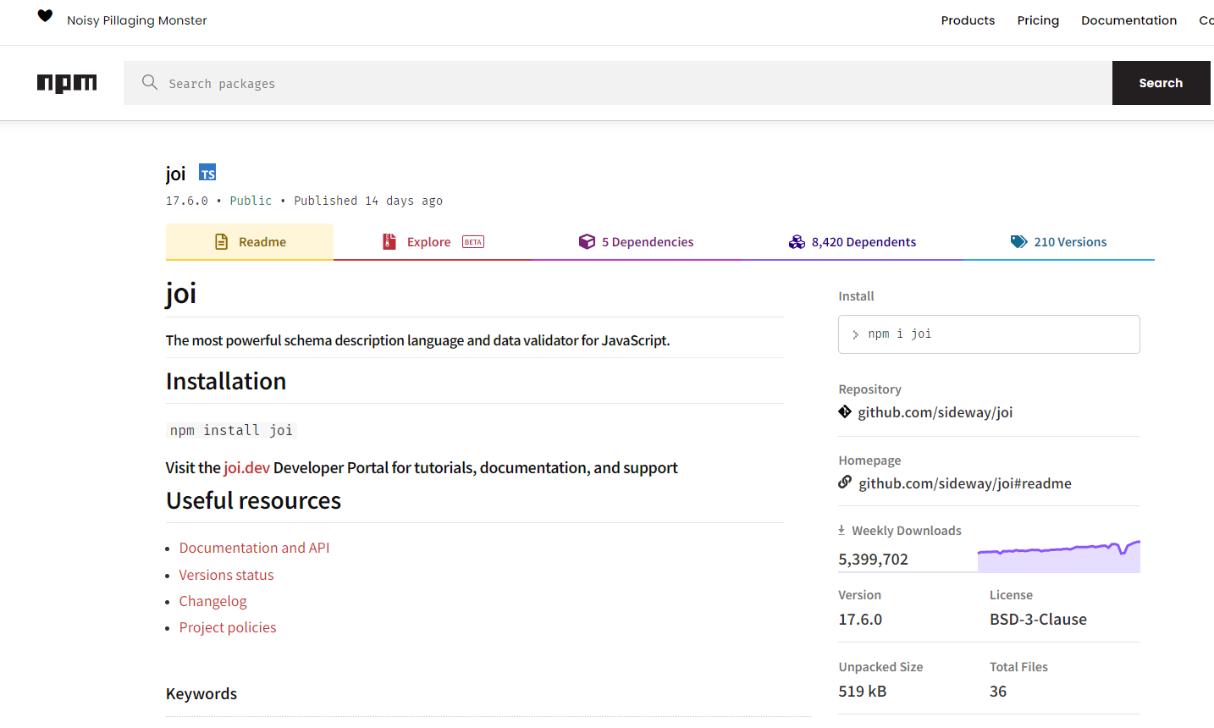
Node Package For Input Validation

Slide 22
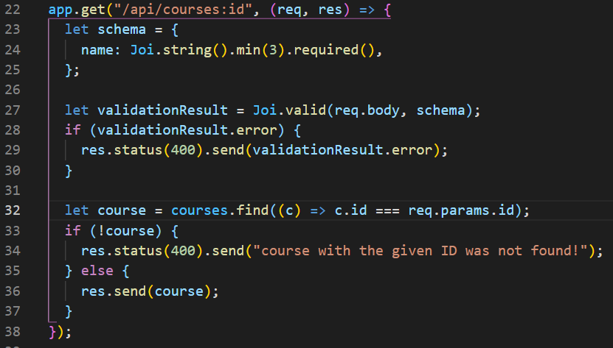
Using Joi package for input validation

Slide 23
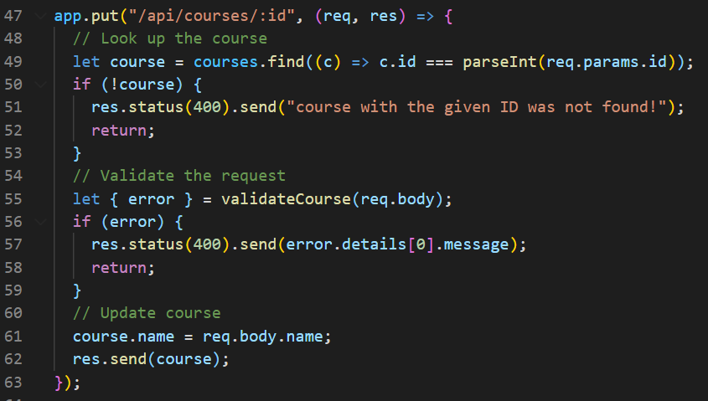
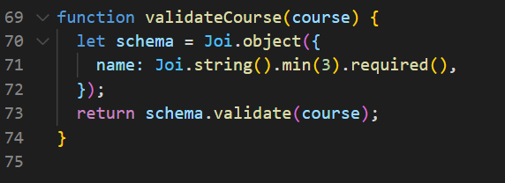
Handling HTTP PUT Requests

Slide 24
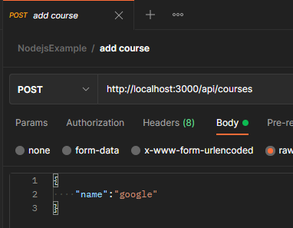
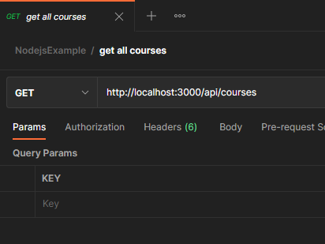
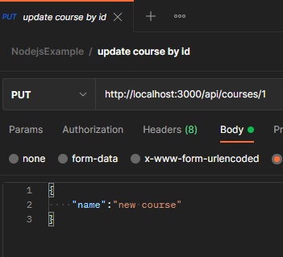
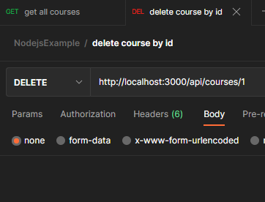
Postman

Slide 25
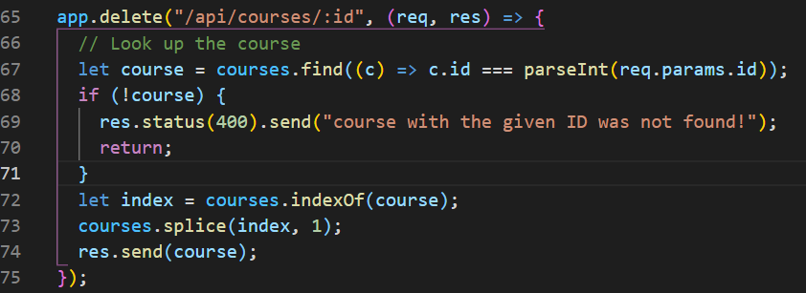
Handling HTTP Delete Requests

Slide 26
Building RESTful APIs with Express
You learned that:
REST defines a set of conventions for creating HTTP services:
POST: to create a resource-PUT: to update it-GET: to read it
DELETE: to delete it
Express is a simple, minimalistic and lightweight framework for building web servers.
- You should never trust data sent by the client. Always validate! Use Joi package to perform input validation.

